Slide 1
ARM-DSP Multicore Considerations
CT Scan Example

Slide 2
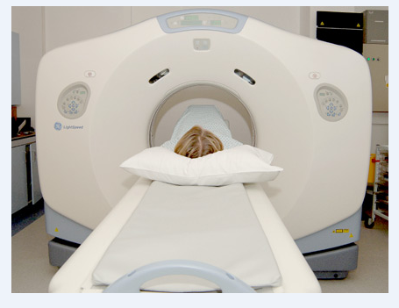
CT Scan Machine
X-Ray source is rotating around the body
Set of detectors (1D, 2D) collects values
Requirements:
Minimize exposure to X-Ray
Obtain good quality view of the internal anatomy
Technician monitors the quality of the imaging in real-time.

Slide 3
Computerized Tomography – Trauma Case
Scanning hundreds slices to find if there is internal damage. Each slice takes about a second.
At the same time, a physician sits in from of the display and has the ability to manipulate the images:
Rotate the images
Color certain values
Edge detection and other image processing algorithms

Slide 4
CT Algorithm (1)
A typical system has a parallel source of X-Rays and a set of detectors.
Each detector detects the absorption of the line integral between the source and the detector.
The source rotates around the body and the detectors collect N sets of data.
The next slide will demonstrate the geometry (taken from Digital Picture processing, Rosenfeld and Kak).

Slide 5
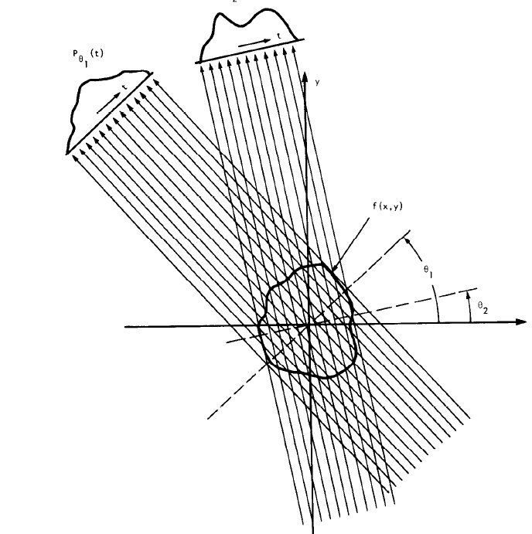
CT Algorithm(2)

Slide 6
CT Algorithm(3)
CT processing has four parts:
Preprocessing
Back projector
Post processing
3D processing

Slide 7
Pre-processing
Performed on each individual set of data collected from all detectors in single angle.
Conversion from absorption values to real values.
Compensate on the variance in the geometry and detectors.
Dead detectors are interpolated
Interpolation using FFT based convolution (x->2x)
Other vector filtering operations (secret sauce)

Slide 8
Back Projector
For each pixel accumulates the contributions of all the lines that passed through the pixel
It involves interpolation between two rays, and adding to a value

Slide 9
Post-processing Image processing
2D filtering on the image:
Scatter (or anti-scatter) filter
Smooth filter (LPF) for a smoother image
Edge detection filter (The opposite) for identifying edges
Setting the range for display (floating point to fixed point conversion)
Other image based operations

Slide 10
3-D processing
Using multiple slices to build 3D model

Slide 11
“My System”
800 detectors in a vector
Scan time – 1 second per slice
360 vectors per slice
Image size 512x512 pixels
400 slices per scan

Slide 12
Memory and IO Considerations
Input data per second 800 * 360 * 2 = 562.5 K Bytes
Total input data (562.5K x 400) =~ 198MB
Image memory holds 400 slices, 512x512 floating point each 512x512x4x400 = 400MB
Pre-process single vector
Input size (single vector) 800 samples by 2 bytes –less than 2KB
Largest intermediate size (interpolated to 2048, complex floating point) 2048*4*2 = 16KB
Output size (real) 2047 x4 = 8KB
Filters coefficients, convolution coefficients etc –> 16KB

Slide 13
Memory and IO Considerations “My System”
Back projector processing
Image size 512x512x4 = 1M
Post processing and 3D processing
400 images, 400M

Slide 14
System considerations
When scanning starts, images are processed in the rate of one image per second.
The operator needs to verify that all the settings are correct and that the configuration is correct. Operator looks at a single image at a time and changes the image setting.
The operator looks at images slower than one per second and needs flexibility in setting image parameters and configurations. The same is true for 3D manipulations
The operator does not have to look at all the images. So the image reconstruction rate is 1 per second, the image display rate (or 3D display) is much slower.

Slide 15
ARM - DSP considerations
The ARM NEON and the FPU are optimized for vector/matrix bytes or half word operations. Linux has many image processing libraries and 3D emulation libraries available.
Intuitively it looks like the ARM core will do all the image processing and the 3D processing.
DSP cores are very good in filtering, FFT, convolution and the like. The back projector algorithm can be easily implemented by DSP code.
Intuitively, it looks like the 8 DSP cores will do the preprocessing and the back projection operation.

Slide 16
My System Architecture

Slide 17
Building and Moving the Image
In my system, the DSPs build the images in the shared memory
Unless shared by multiple DSPs (details later), L2 is too small for a complete image (1MB), and MSMC memory is large enough (up to 6MB) and closer to the DSP cores (than the DDR)
Moving a complete back-projector image to DDR can be done in multiple ways:
One or more DSP cores
EDMA (in ping-pong buffer setting)
ARM core can read directly from the MSMC memory and write the processed image to DDR (again, in ping-pong setting)
Regardless of the method, communication between DSP and ARM is essential.

Slide 18
Partition Considerations: Image Processing
ARM core L2 cache is 4MB
Single image size is 1MB
Image processing can be done in multiple ways:
Each A15 processes an image
Each a15 processes part of an image
Each a15 processes a different algorithm
3D processing partition depends on the algorithm

Slide 19
Image Processing: Each A15 Processes a Different Image
A15 supports write-through for L1 and L2 cache
If the algorithm can work in-place (or does not need intermediate results), each A15 can process a different image. Each image is 1MB.
Advantage: Same code, simple control
Disadvantage: Longer delay, not efficient if intermediate results are needed (for the not-in-place case)

Slide 20
Image processing – Each A15 processes a part of the image
The cache size supports double buffering and working area
Intermediate results can be maintained in cache, output written to a non-cacheable area
Advantage: all data and scratch buffers can fit in the cache, efficient processing, small delay
Disadvantage – need to pay attention to the boundaries between processing zones of each A15

Slide 21
Image Processing: Each A15 Processes Part of the Algorithm
Pipelines the processing, four images in the pipeline, requires buffers
Advantage: Each A15 has a smaller program, can fit in the L1 P cache
Disadvantage: Complex algorithm, difficult to balance between A15, not efficient if memory does not fit inside the cache.

Slide 22
So What Method Would You Choose?
Looks like the second case (each A15 processes quarter of the image) is the preferred model.

Slide 23
DSP Cores Partition
There are 360 vectors (each slice). The complete preprocessing of each vector is done by a single DSP core
No reason to divide preprocessing of a single vector between multiple DSPs
Partition preprocessing and back projector:
Some DSPs do preprocessing and some back projector (Functional Partition) OR
All DSPs do both preprocessing and back projector (Data Partition)

Slide 24
Partition Back Projector and Preprocessing
N DSPs do preprocessing, 8-N back projector
N is chosen to balance load (as much as possible)
Vectors are moved from the preprocessing DSPs to the back projector DSP using shared memory or navigator

Slide 25
Input Vector Partition
Each DSP sums a complete image
Vectors are divided between DSPs
Because of race conditions, each DSP has a local (private) image. At the end one DSP (or ARM) combine together all the local images. Private images resides outside of the core
Does not require broadcasting of vector values

Slide 26
Input Vector Partition
Each DSP sums part of the image
Vectors are broadcast to all DSPs
Depends on the number of cores, partial image can fit inside L2
Merging together into shared memory (DDR) at the end of the partial build

Slide 27
All DSPs Do Preprocessing and Back Projector
Just like the previous case, there are two options, either each DSP builds part of the image or all DSP build partial image and then all partial images are combined into the final image

Slide 28
Input Vector Partition
Each DSP sums a complete image
Raw vectors are divided between DSPs
Because of race conditions, each DSP has a local (private) image. At the end one DSP (or ARM) combine together all the local images. Private image resides outside of the core
Does not require broadcasting of raw vector values

Slide 29
Input Vector Partition
Each DSP sums part of the image
Raw vectors are broadcast to all DSPs
Depends on the number of cores, partial image can fit inside L2 in addition to the filter coefficients
Merging together into shared memory (DDR) at the end of the partial build

Slide 30
So What Method Would You Choose?
The optimal solution depends on the exact configuration of the system (number of detectors, number of rays, number of slices) and the algorithms that are used.
Suggest to benchmark all (or subset) of the possibilities and choose the best one for a specific problem
Any Questions?

